Slide 1
Deep Dive Into Constraint Layout

Slide 2
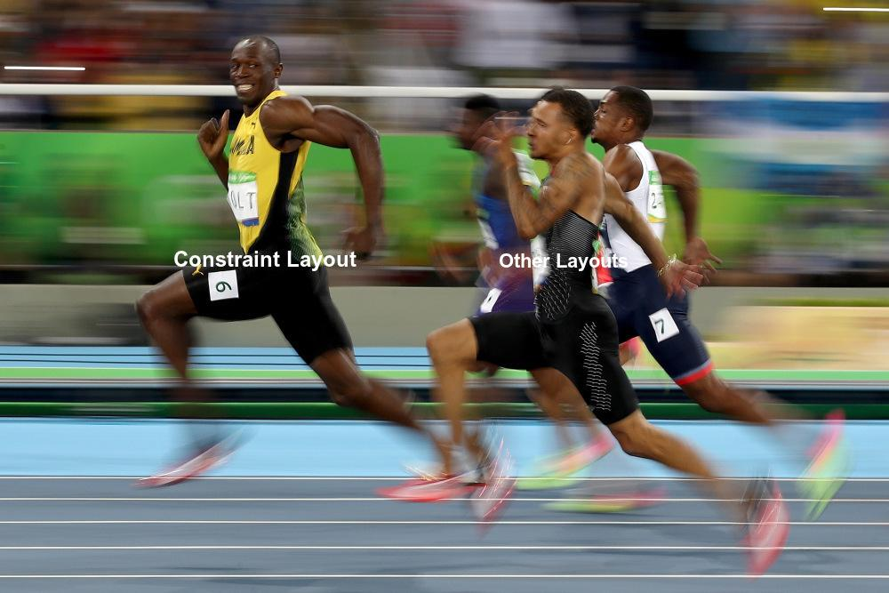

Slide 3
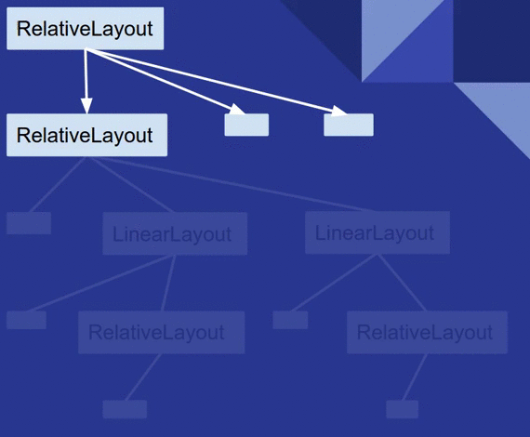
View Drawing
Measure
Take measurement of each view
Layout
Calculate the position of each children view
Draw
Actual Drawing happen via sending commands to GPU as per the calculation in first two steps

Slide 4

Problems with Standard Layouts
Deep nested view hierarchies do not perform well
Customization is limited
Animations are not easy

Slide 5
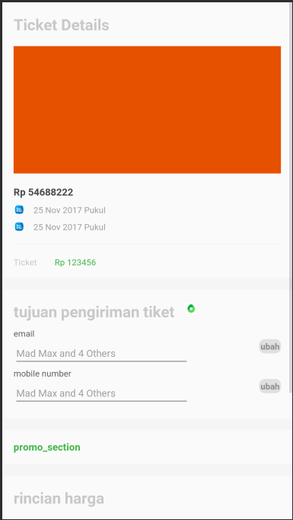
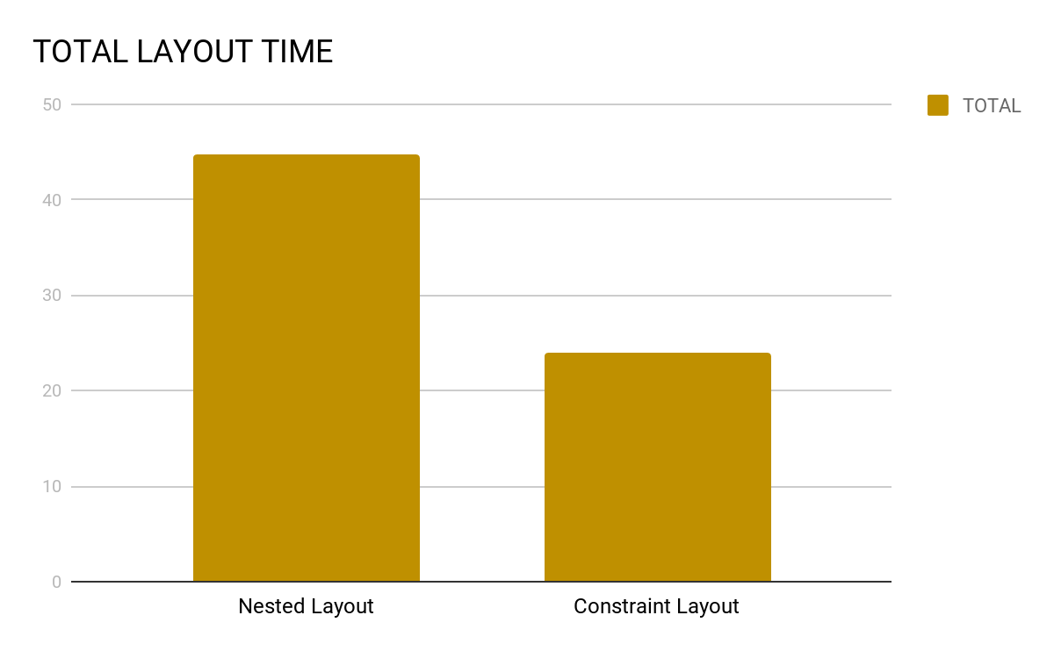
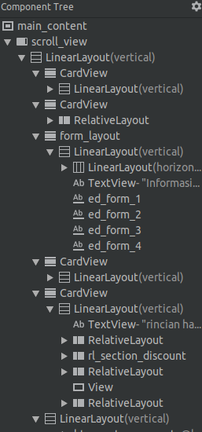
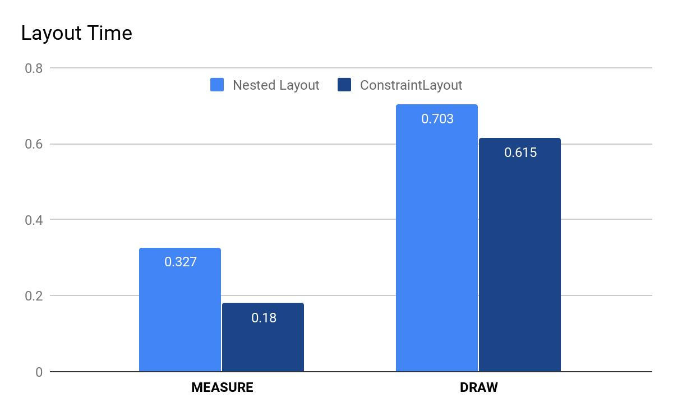
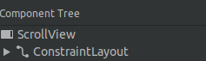
Constraint Layout vs Others
Measure - 0.327 vs 0.180 ms Draw - 0.703 vs 0.615
Total - 44.745ms vs 23.980ms

Slide 6
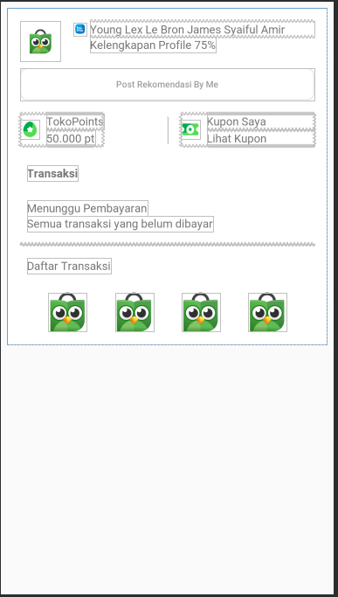
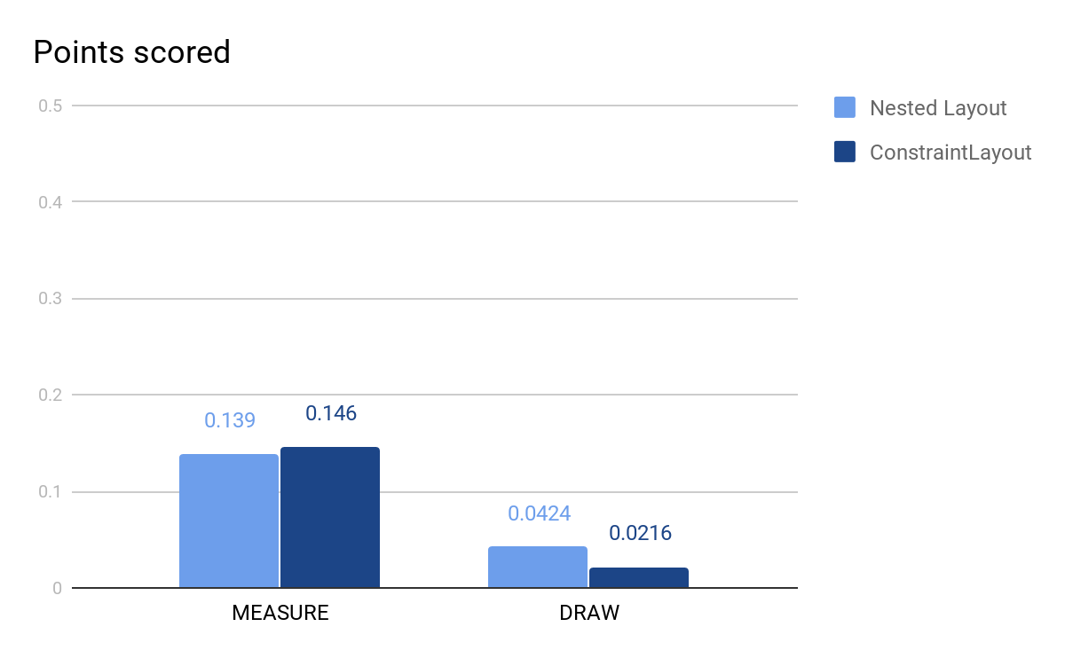
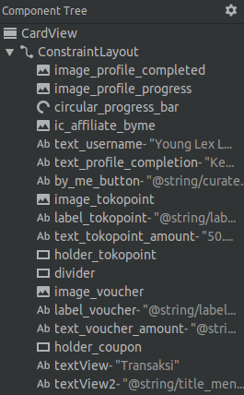
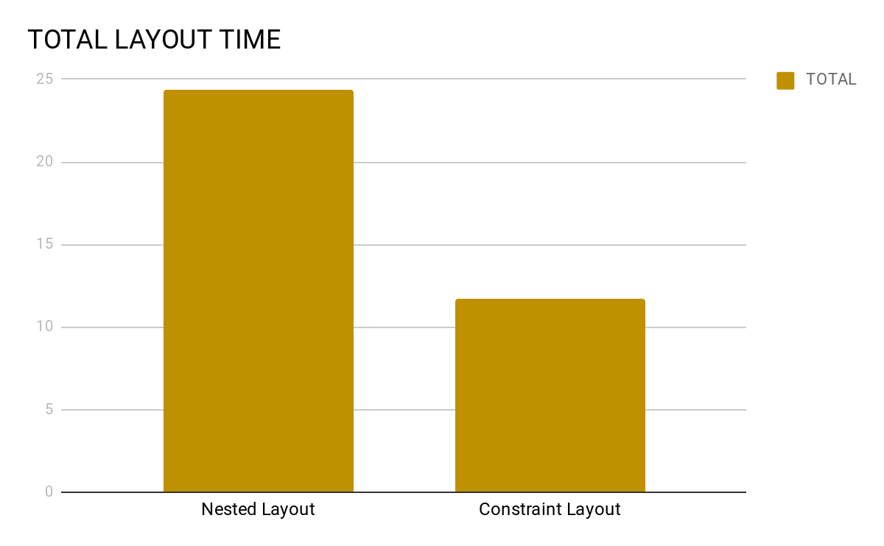
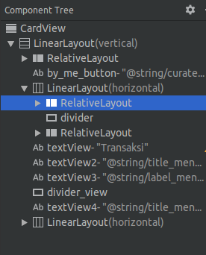
Constraint Layout vs Others
Measure - 0.139 vs 0.146 ms Draw - 0.0424 vs 0.0216
Total - 24.365 vs 11.704 ms
Standard Deviation really low 11.418, 11.134,11.197,13.29,11.480…..

Slide 7
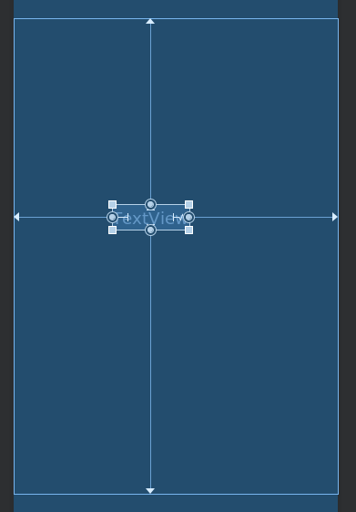
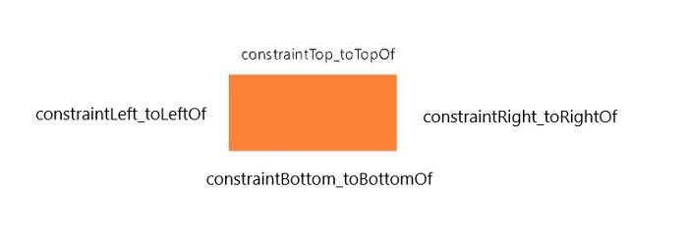
Constraints :-
Constraints allow you to position a given widget relative to another one. For Example:-
layout_constraint[SourceAnchor]_[TargetAnchor]="[TargetId]"

Slide 8
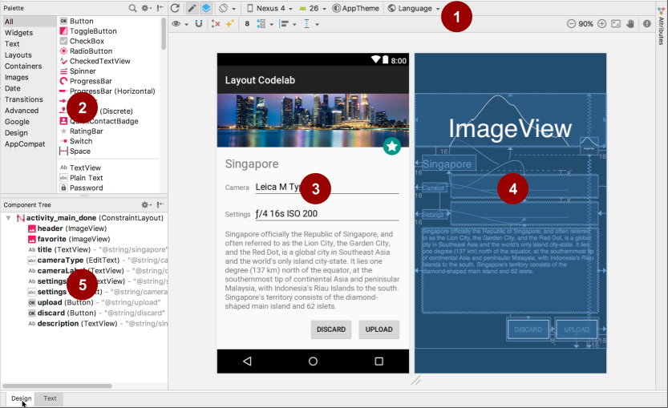
Layout Editor
Figure shows the Layout Editor's components:
Toolbar
Palette
Design view
Blueprint view
Component Tree

Slide 9
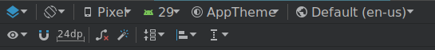
Toolbar
Figure shows the toolbar components:
Design Surface
Orientation
View options
Auto connect
Default margins
Guidelines
Clear constraints
Infer Constraints
Align

Slide 10
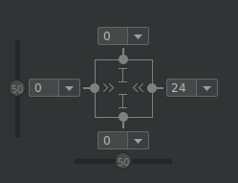
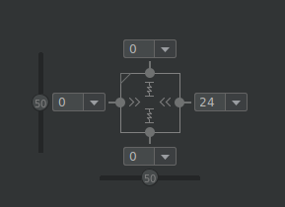
View Inspector
fixed
wrap_content
Margin values appear on all four sides. Change a margin by clicking the value and choosing a different value.
Inner lines indicate the constrained width and length.(fixed, match constraints and wrap content)
Use sliders to change the horizontal and vertical constraint bias for elements with opposing constraints.
The measure of space between the element and the layout's border is known as the constraint bias.
match_constraint

Slide 11
Match constraint - Properties
layout_constraintWidth_min layout_constraintHeight_min : | To define min width or height respecting constraints
layout_constraintWidth_percent layout_constraintHeight_percent | To define width or height in percentage with respect to parent
layout_constraintWidth_max layout_constraintHeight_max | To define max width or height respecting constraints
layout_constraintwidth_default layout_constraintheight_default | Spread, Wrap, Percent

Slide 12
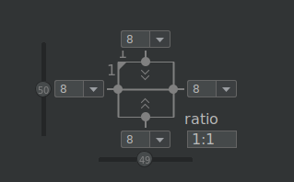
Ratio
You can also define one dimension of a widget as a ratio of the other one.
<Button android:layout_width="wrap_content"
android:layout_height="0dp"
app:layout_constraintDimensionRatio="1:1" />
To constrain one specific side based on the dimensions of another, you can pre append W," or H, to constrain the width or height respectively.
<Button android:layout_width="0dp"
android:layout_height="0dp"
app:layout_constraintDimensionRatio="H,16:9"
app:layout_constraintBottom_toBottomOf="parent"
app:layout_constraintTop_toTopOf="parent"/>
(Toggle aspect ratio constraint also available in editor layout)

Slide 13
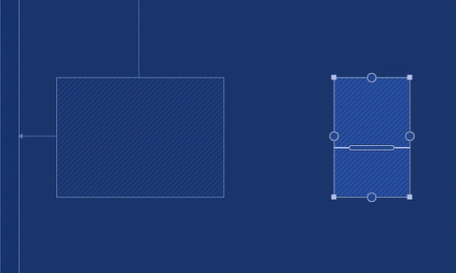
Baseline
Gone Margin
To align the baseline of multiple textviews, regardless of
their text sizes. app:layout_constraintBaseline_toBaselineOf
New attributes available to specify another margin when a targeted view constraint is gone.

Slide 14
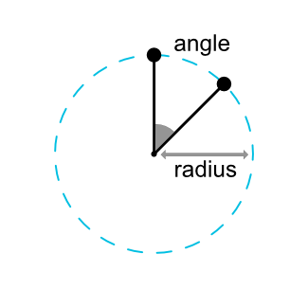
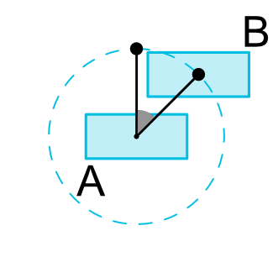
Circular Constraints
A widget center relative to another widget center, at an angle and a distance.
layout_constraintCircle :
layout_constraintCircleRadius :
layout_constraintCircleAngle :

Slide 15
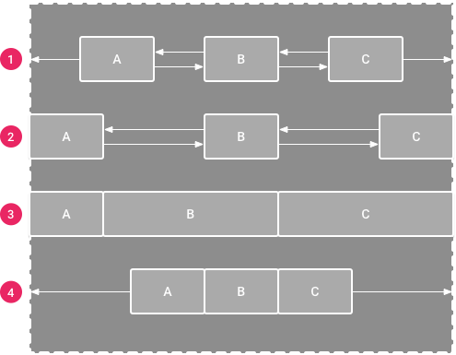
Chains
A chain is a group of views that are linked to each other with bi-directional position constraints. The views within a chain can be distributed either vertically or horizontally.
Spread
Spread inside:
Weighted: in CHAIN_SPREAD mode, if some widgets are set to MATCH_CONSTRAINT
Packed

Slide 16
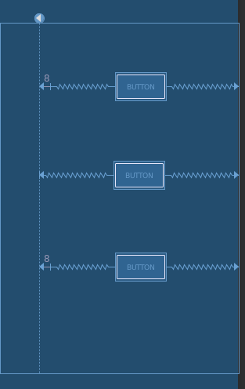
Guidelines
Virtual helper anchors that won’t be displayed in your app, and are only used for layout purposes.
layout_constraintGuide_begin
layout_constraintGuide_end
layout_constraintGuide_percent

Slide 17
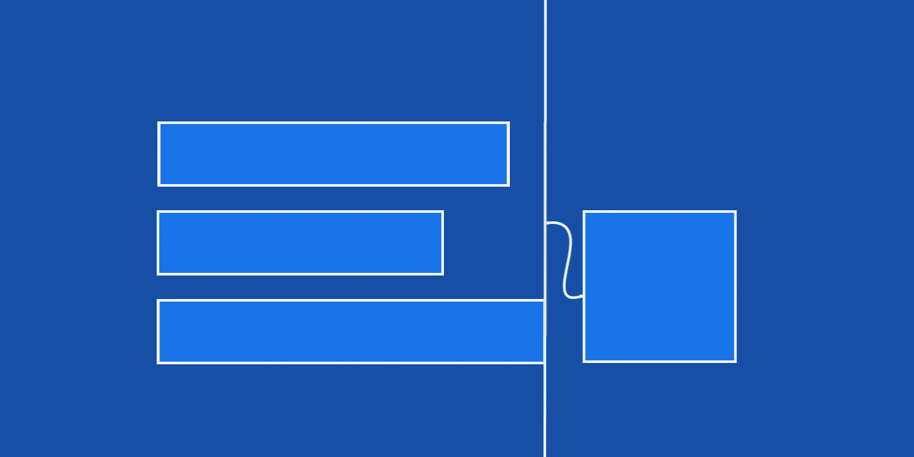
Barriers and Groups
Barriers:
References multiple widgets
Creates a virtual guideline based on the most extreme widget on the specified side.
Also takes position of gone views in consideration
Groups:
Sometimes you need to show or hide several elements at once. To support this, Constraint Layout added groups.

Slide 18
Placeholders
A Placeholder provides a virtual object which can position an existing object.
When the id of another view is set on a placeholder (using setContent()), the placeholder effectively becomes the content view. If the content view exist on the screen it is treated as gone from its original location.
<androidx.constraintlayout.widget.Placeholder

Slide 19
Constraint Sets
Contains all of the constraints of all the views in the layout.
It is the constraint layout minus the view part
Allows you to define programmatically a set of constraints to be used with ConstraintLayout
Can be created
from a R.layout.* object cnset.clone(context, R.layout.layout1);
from another ConstraintLayout cnset.clone(cnstrtlayout);
directly from XML file cnset.load(context, R.xml.mainxml);
public class MainActivity extends AppCompatActivity {
ConstraintSet mConstraintSet1 = new ConstraintSet(); ConstraintSet mConstraintSet2 = new ConstraintSet(); ConstraintLayout mConstraintLayout; boolean mOld = true;
@Override
protected void onCreate(Bundle savedInstanceState) {
super.onCreate(savedInstanceState);
Context context = this;
mConstraintSet2.clone(context, R.layout.state2);
setContentView(R.layout.state1);
mConstraintLayout = findViewById(R.id.activity_main);
mConstraintSet1.clone(mConstraintLayout);
}
public void foo(View view) {
if (mOld = !mOld) {
mConstraintSet1.applyTo(mConstraintLayout); } else {
mConstraintSet2.applyTo(mConstraintLayout); }
}

Slide 20
Constraint Sets
connect()- (int startID,int startSide,int endID,int endSide,int margin) startID- view to be constrained startSide- side of view to be constrained endID- id of view to be constrained to endSide- side of view to constrained to margin- margin between sides
setVisibility()
createHorizontalChain()
constrainDefaultWidth()
constraintSet2.connect(R.id.iv_photographer, ConstraintSet.TOP, R.id.expanding_bg, ConstraintSet.BOTTOM,0) constraintSet2.setVisibility(R.id.title_name, View.VISIBLE) mConstraintSet2.applyTo(mConstraintLayout);

Slide 21
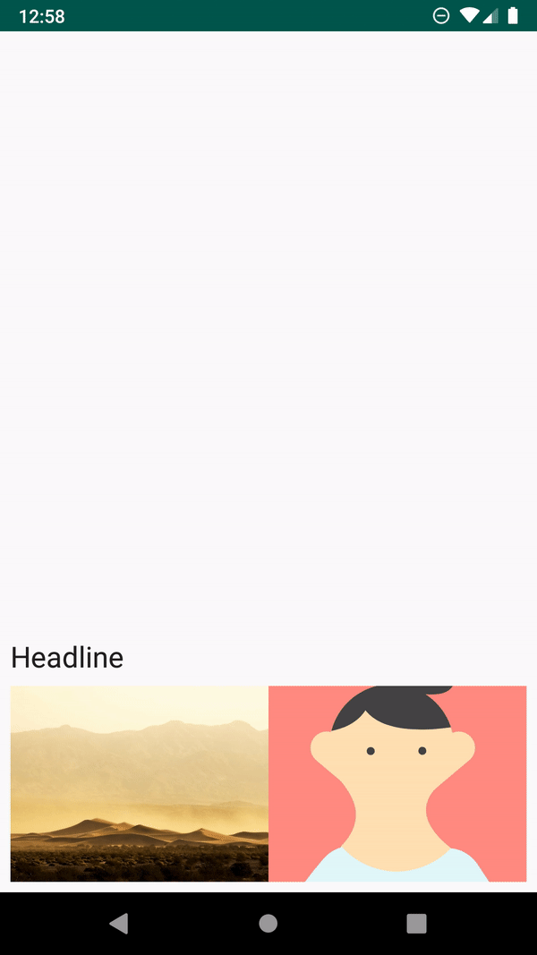
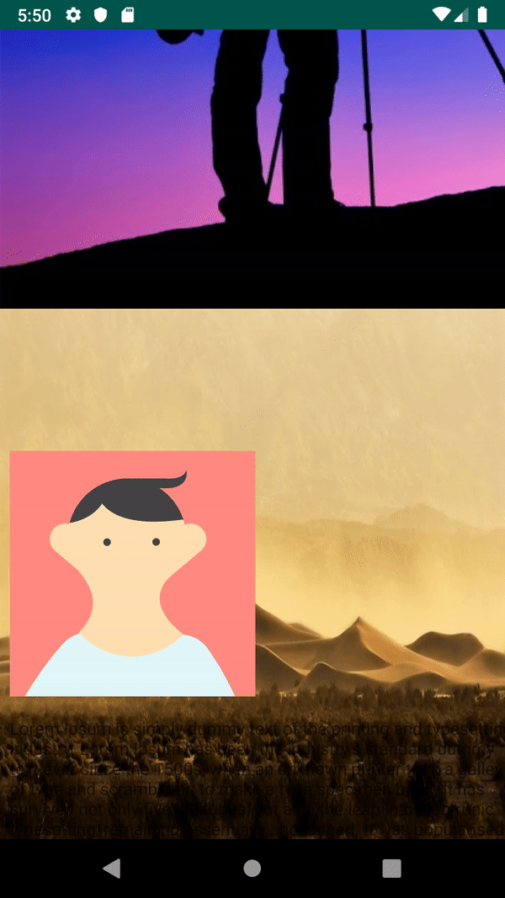
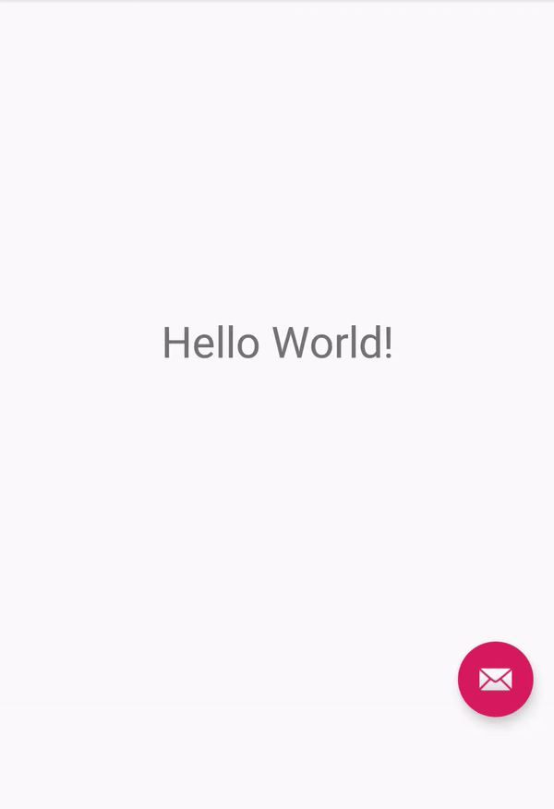
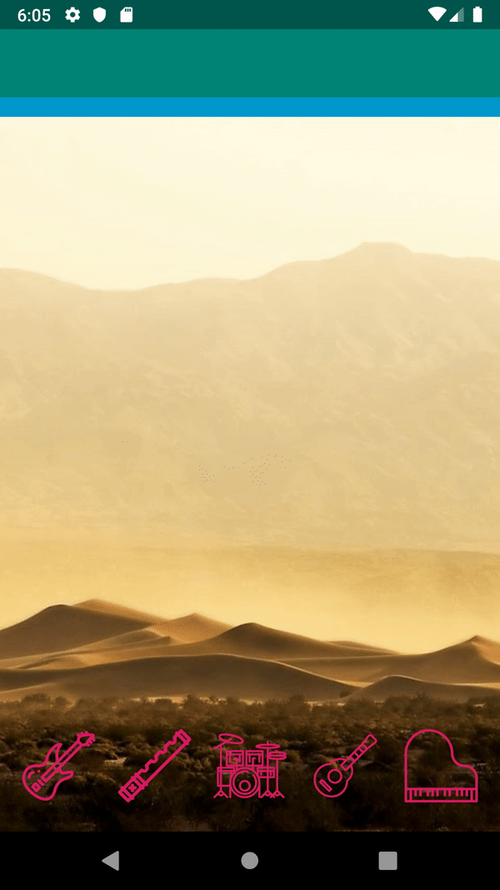
Animations using Constraint Layout

Slide 22


About the Speakers
Pranay Mohapatra Senior Software Engineer
Abhishek Jain Software Engineer

Slide 23



